Slide 1


HushSense
Decentralizing Soundscape Health: We transform the global smartphone network into the world's most trusted, real-time noise pollution data layer for healthier cities.
Vision
A world where every city has comprehensive, real-time noise data that empowers citizens to find tranquility, helps businesses optimize their environments, and enables governments to create evidence-based policies for healthier urban living.Decentralizing Soundscape Health: We transform the global smartphone network into the world's most trusted, real-time noise pollution data layer for healthier cities.
Team HushSense

Slide 2
The Silent Crisis
The Silent Crisis: Unmonitored Noise Pollution in Global Megacities
Verifiable Challenge (African Context)
Rapid, unregulated urbanization in cities like Lagos and Nairobi means most areas lack formal noise monitoring. Governments have no granular, verifiable data to enforce dB standards, leaving millions exposed to chronic health risks.
$40B+
1.6B
70%
Annual Economic Cost
People Affected
Missing Data
Global cost of noise pollution
Exposed to harmful noise levels
Urban soundscape data outdated or absent
Why Unsolvable?
Traditional monitoring relies on expensive, fixed sensors ($10,000+), making comprehensive, block-level coverage impossible for budget-constrained municipalities.

Slide 3

Everyday Noise, Undetected Impact
We've all experienced it: trying to focus in a noisy café, or being disturbed by street sounds at night. The constant drone of construction, loud neighbors, or traffic often goes unaddressed because there's no easy way to quantify or report it.You're studying for an exam, but the music from the bar next door makes concentration impossible.You move into a new apartment that seemed quiet during the viewing, but turns into a noise trap at night.
These daily frustrations highlight a critical issue: pervasive noise pollution, silently eroding our well-being, yet we lack the verifiable data to understand its true extent or take effective action.

Slide 4

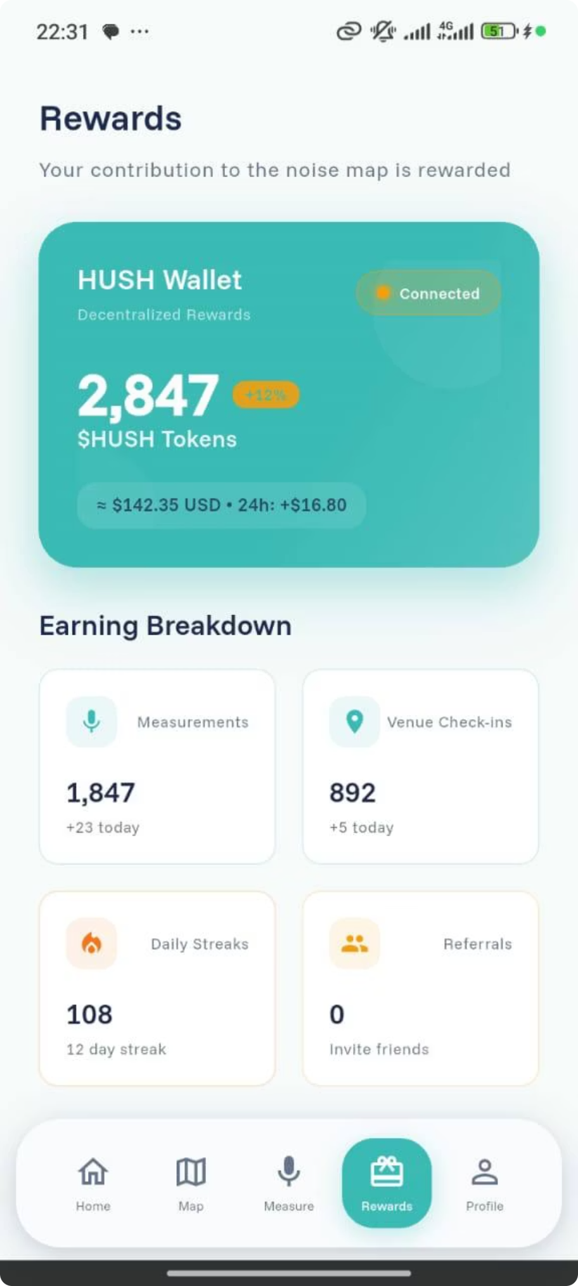
HushSense: Global Real-Time Noise Pollution Map
The Solution
Key Features
A DePIN (Decentralised Physical Infrastructure Network) where citizens use the HushSense mobile app to turn their smartphones into verified, privacy-preserving soundscape sensors.
Real-time mapping with dB readings
Token rewards for contributors
Soundscape First-Mover NFTs
Analytic Dashboard of Noise Dataset.
We use Hedera Hashgraph to reward contributors which gives immutable transaction and low cost ensuring data integrity required by government and commercial buyers.
Cryptographic data security

Slide 5



Infrastructure We Leverage
Global Smartphone Network
Hedera Token Service (HTS)
Hedera Smart Contract Service (HSCS) / EVM
Leveraging the existing global network of smartphones to transform them into verified, privacy-preserving soundscape sensors for real-time data collection.
Used for creating and managing the fungible HUSH token and the NFT collection, facilitating efficient minting of tokens and NFTs, and associating them with user accounts.
Hosts the HushSense Manager contract, which enforces owner-only minting logic and calls HTS precompiles to ensure secure and controlled token operations.

Slide 6
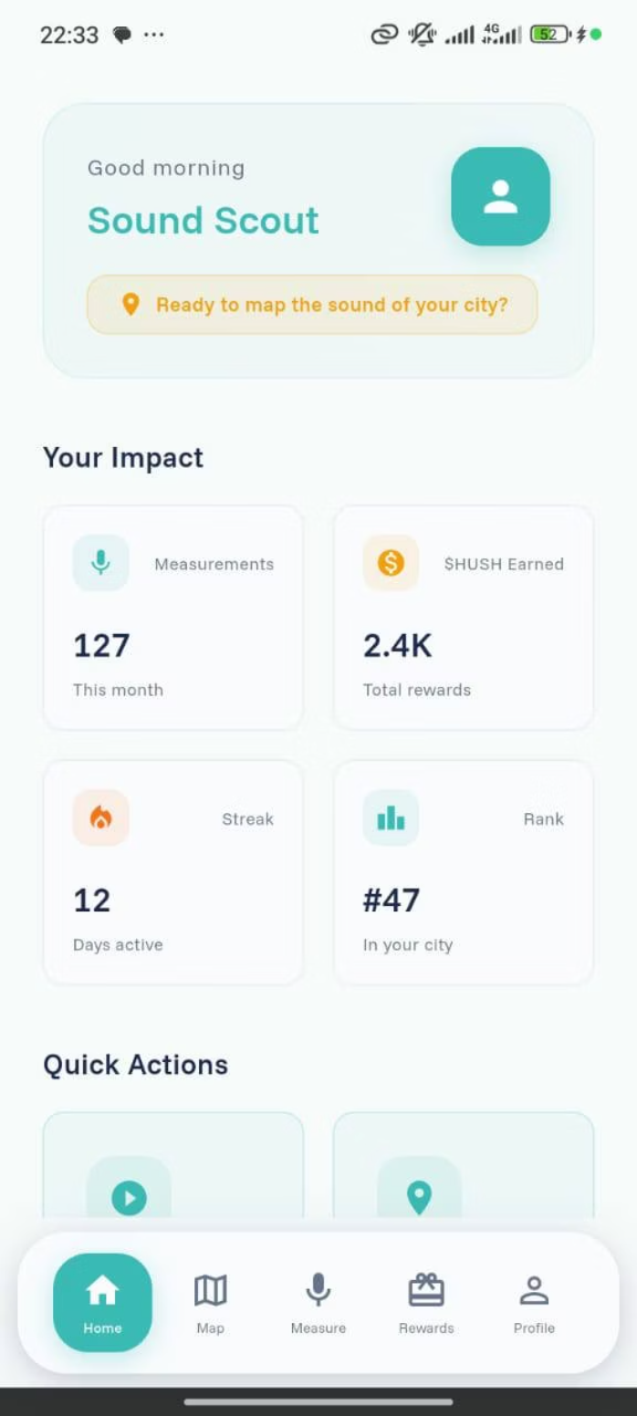
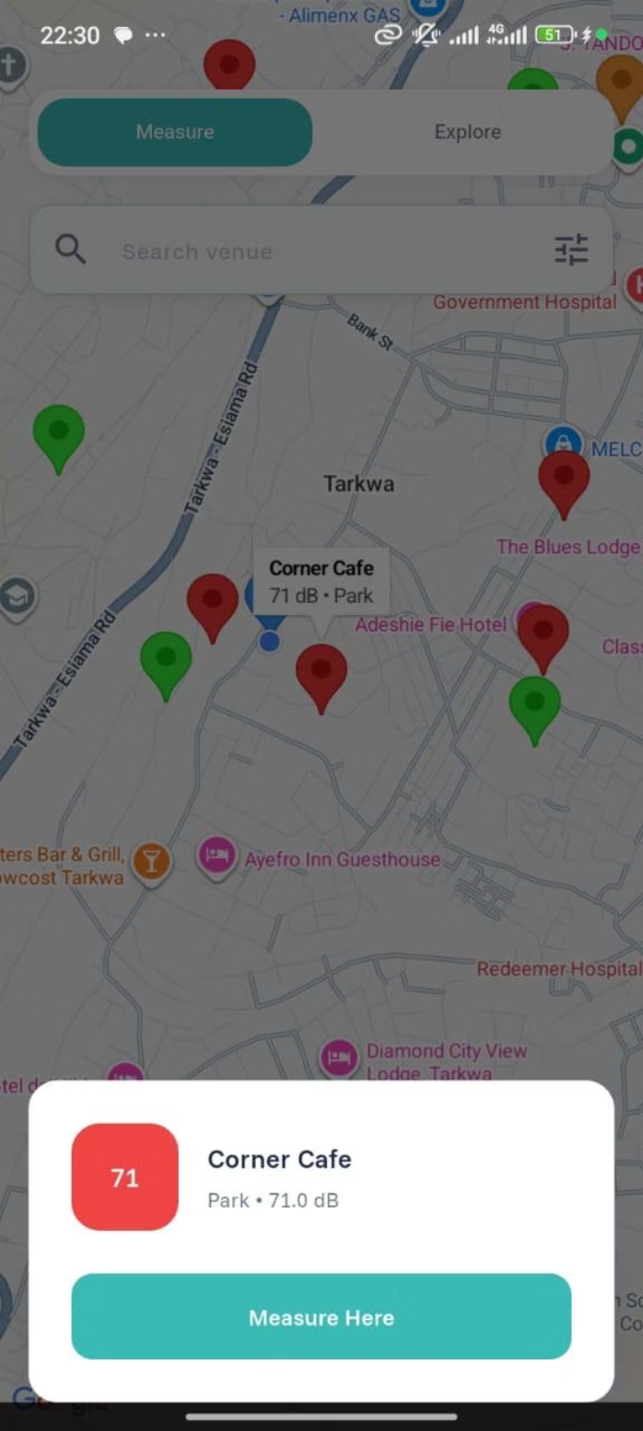
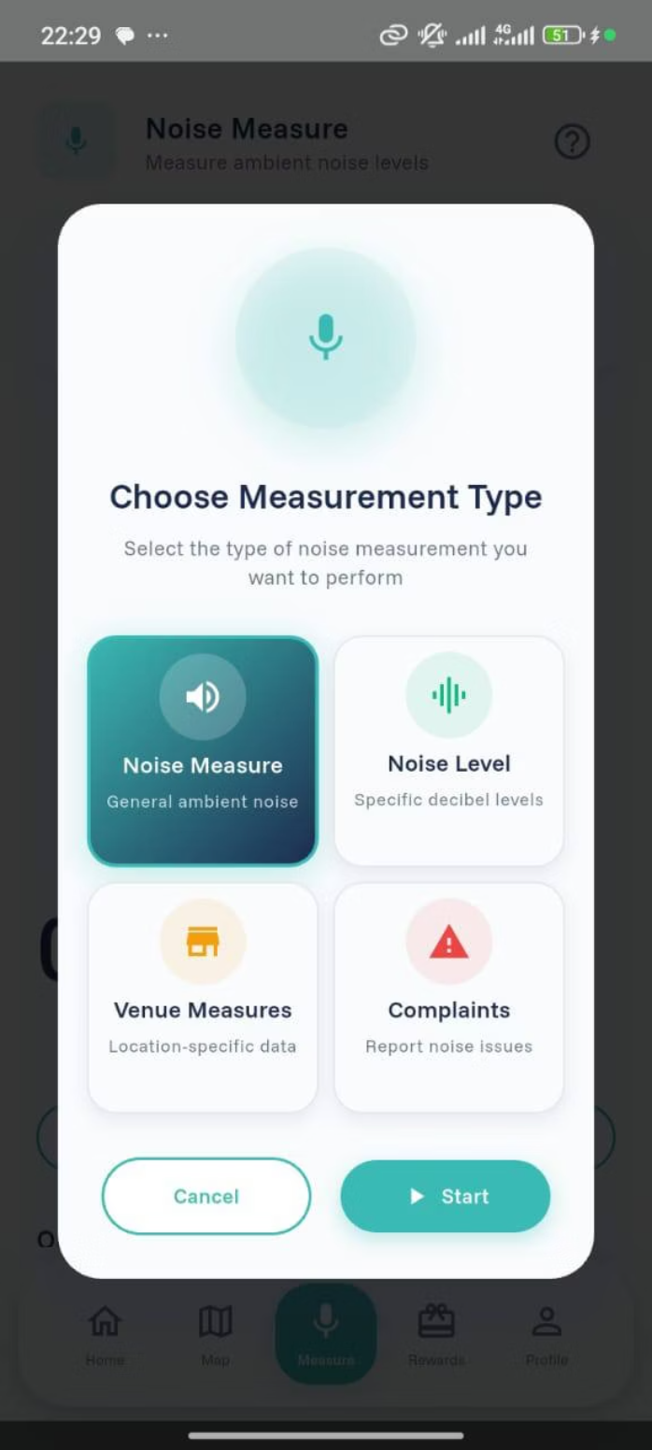
A Glance of HushSense Software
Home Page
Noise Map
Measure Page

Slide 7
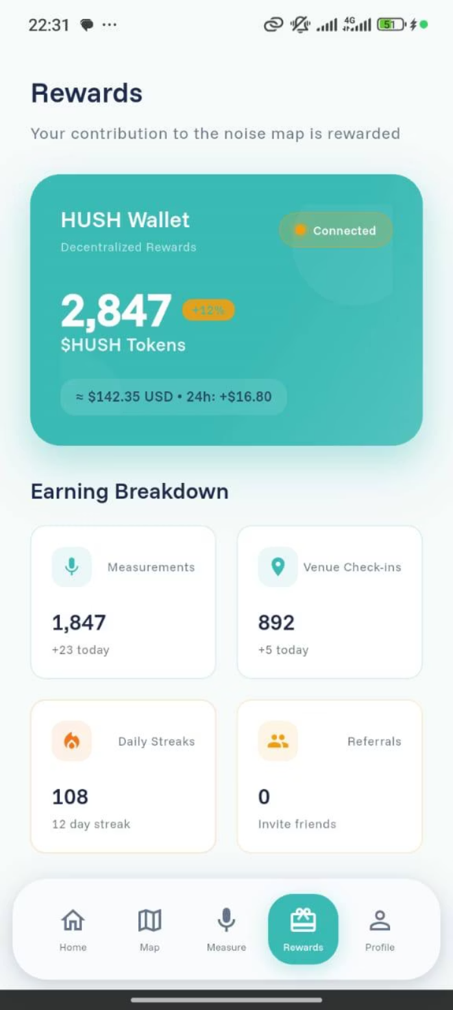
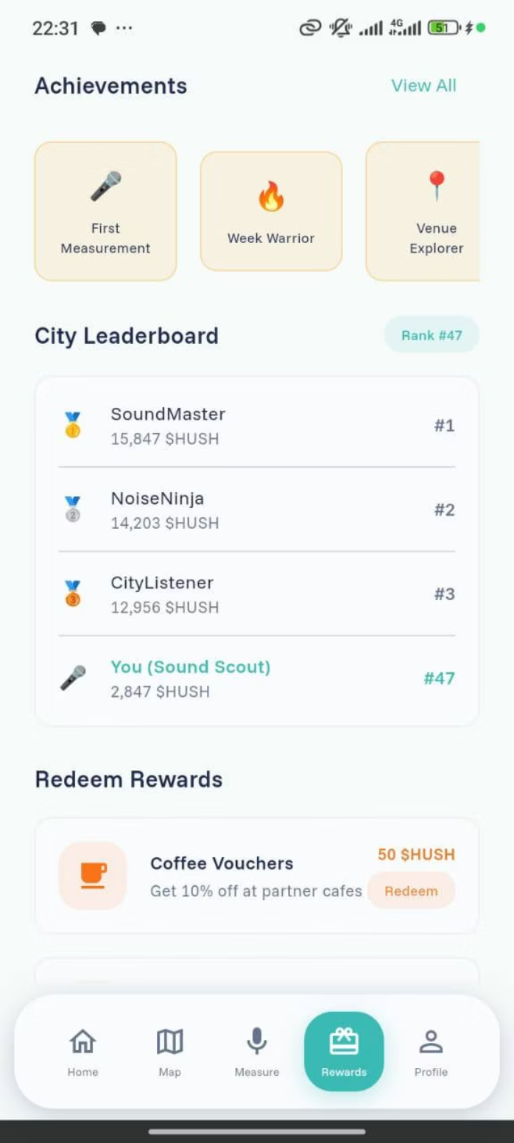
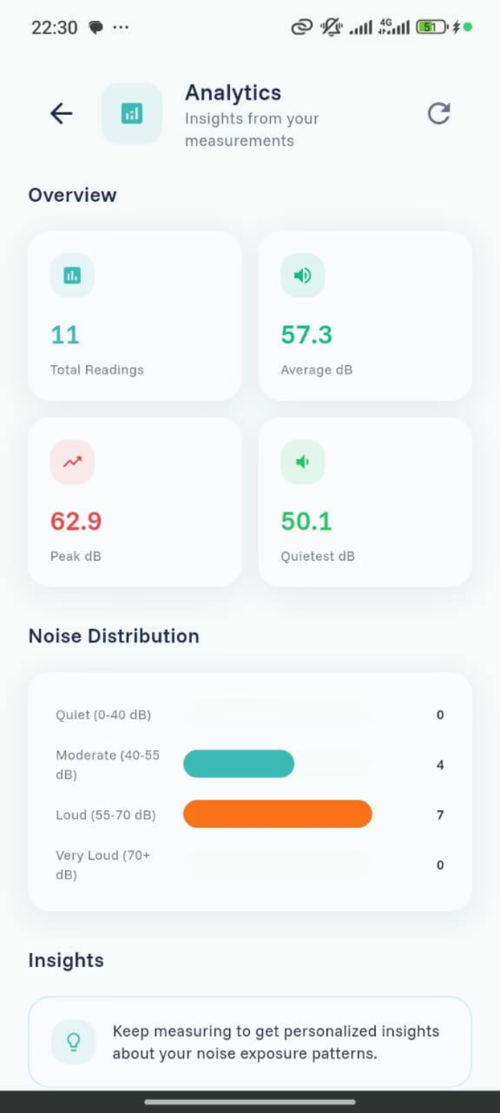
2nd Phase of HushSense Software
Reward Page
Game Dashboard
Analytics Page

Slide 8




The Hedera Advantage
Onboarding massive users onto Hedera with security and sustainability at scale.
ABFT Finality & Trust
Predictable, Low Fees
Hedera's Asynchronous Byzantine Fault Tolerance provides instant finality. We log millions of noise data points securely without risk of forks critical for environmental enforcement data.
Process billions of micro-transactions efficiently. Hedera's predictable, low-cost fees (fraction of a penny) make our reward model economically viable at global scale.
ESG Credentials
Enterprise Ready
Hedera's carbon-negative commitment and energy efficiency perfectly align with our mission to build a healthier, sustainable future.
The Hedera Governing Council provides stability and enterprise-grade legal framework required for selling data to corporate and government clients.

Slide 9



Mapping the $100B Environmental Data Economy
TAM: $100B+
1
Global environmental/urban data and ESG compliance market
SAM: $10B
2
Hyperlocal acoustic data in top 50 global megacities (Lagos, Cairo, Kenya)
SOM: $50M (Year 3)
3
Data sales in 5 key African cities and 10 major corporate contracts
Target Customers
Primary Buyers
Secondary Buyers
African municipalities
Hotels and hospitality
African Governments
Restaurants
Environmental agencies
Entertainment venues
Urban planning firms
Real estate developers

Slide 10
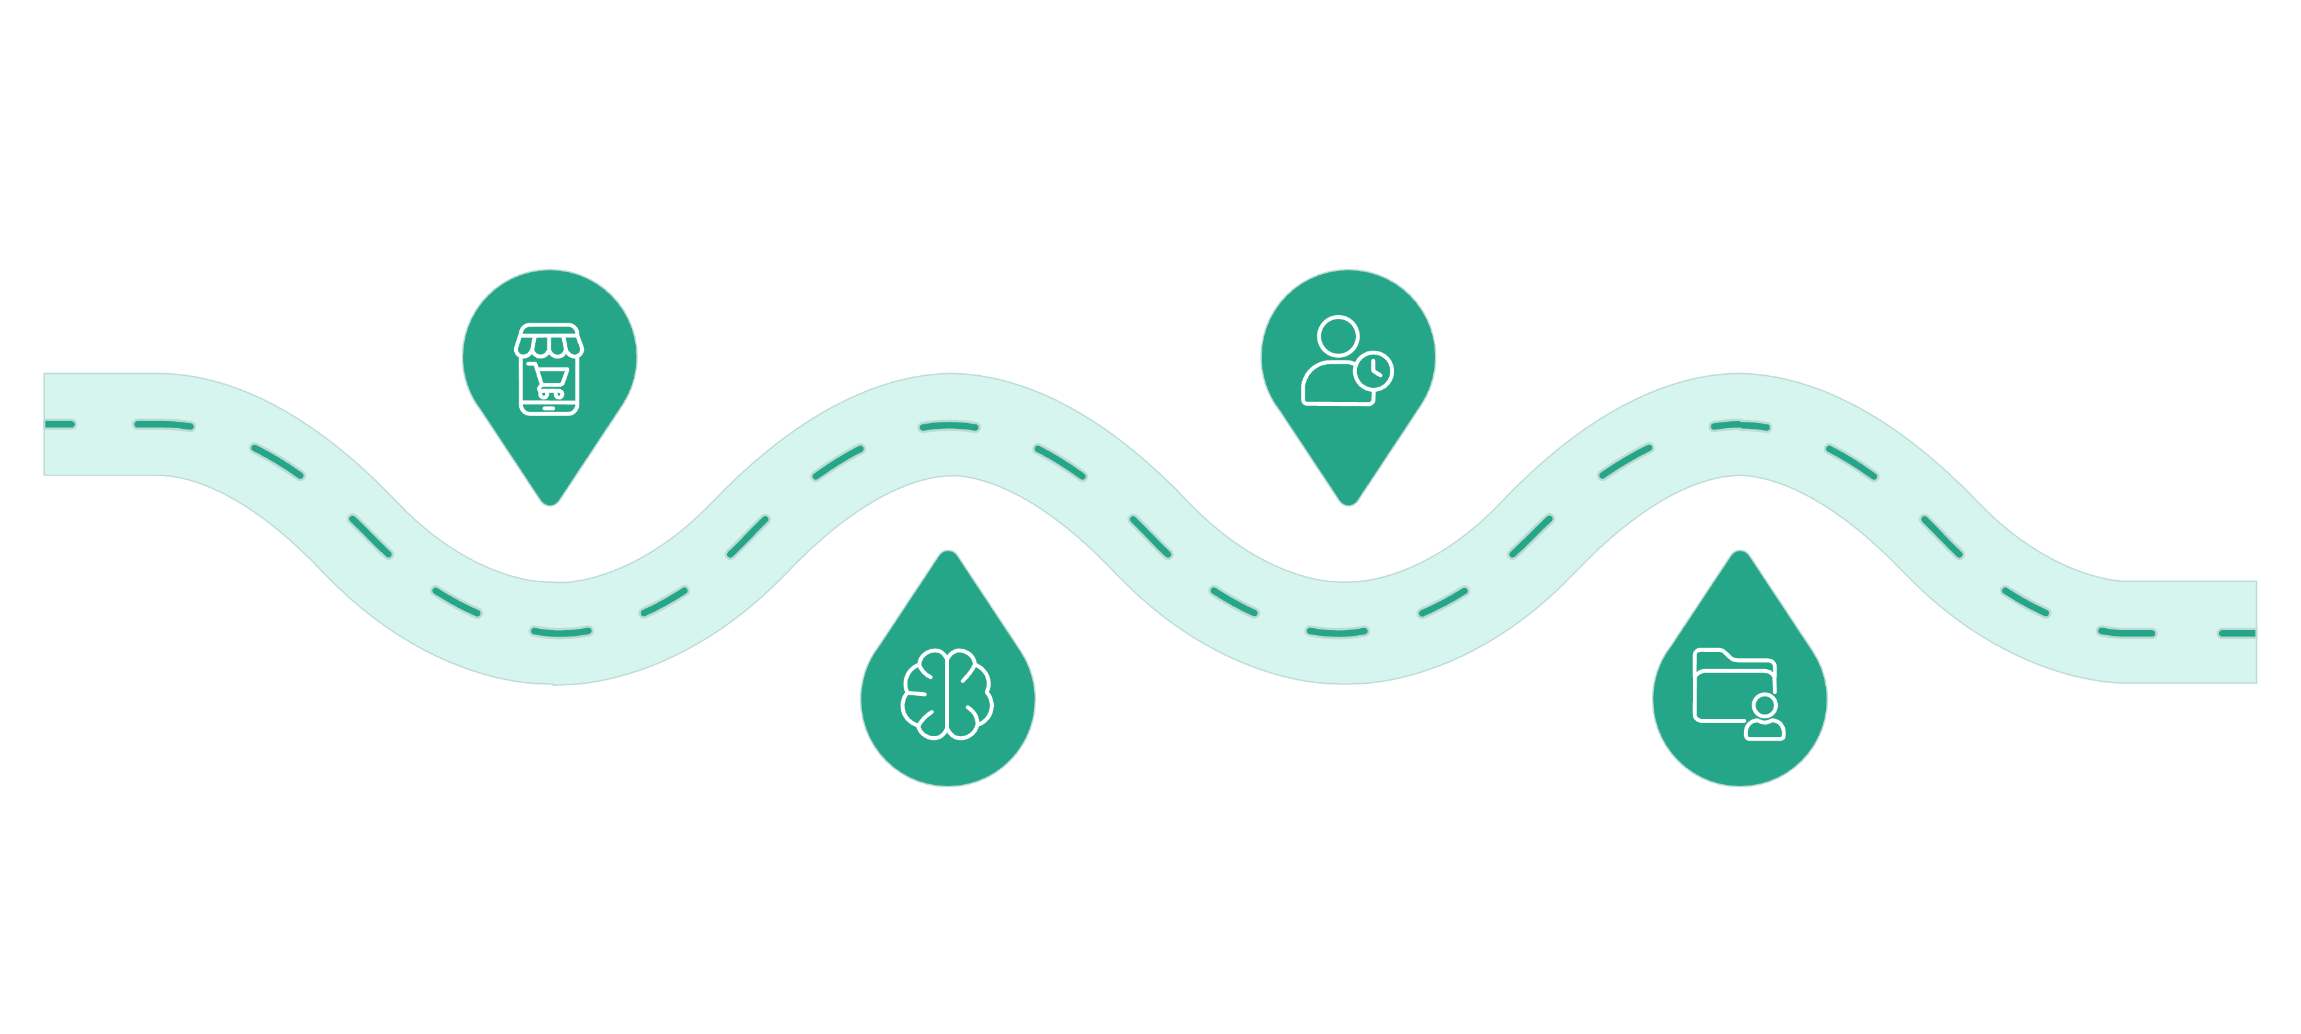


Architecture: Smartphone to Soundscape
Timestamping
Data Capture
Hedera Consensus Service records immutable timestamps
Mobile App collects sound readings
AI Validation
Data Access
HushSense classifies and checks integrity
Decentralised Warehouse provides buyer access
Hedera Integration Points
Hedera Consensus Service (HCS)
Hedera Token Service (HTS)
Recording all validated transactionand minting of NFT with immutable timestamps
Minting $HUSH tokens and Soundscape First-Mover NFTs
TRL Status: MVP complete : mobile application running, $Hush token deployed on mainnet, Soundscape First-Mover NFT Minted on Mainnet, data logging to Hedera HCS implemented, basic reward calculation logic operational.

Slide 11
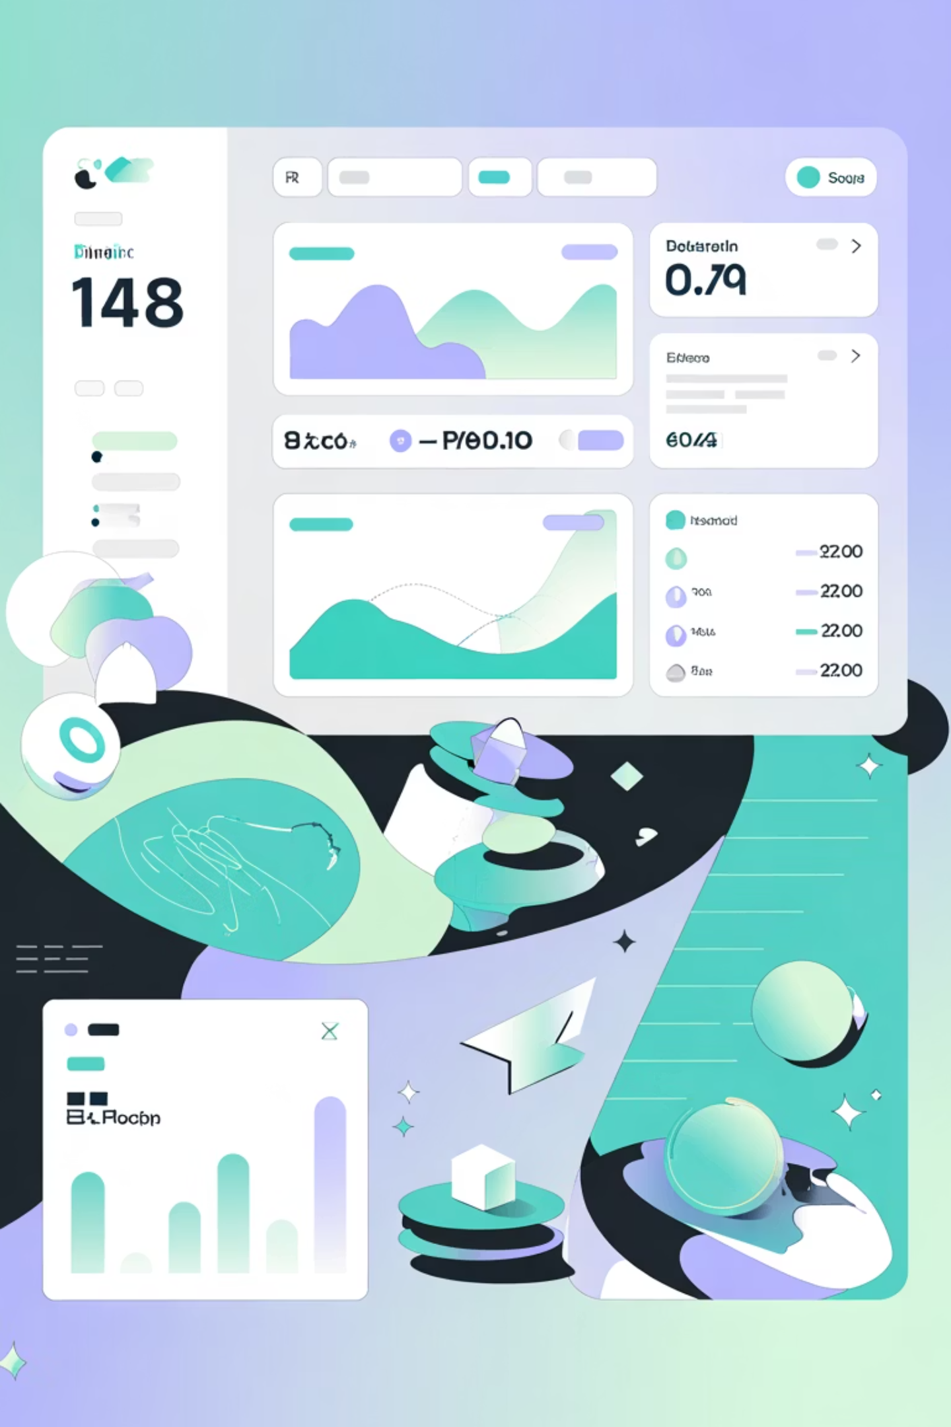



Data as the Decentralised Revenue Stream
Who Pays?
Data consumers: governments, planners, real estate firms, and hospitality businesses pay for access to verified, historical, and real-time HushSense data.
Tier 1: $Hush Token
Long-term corporate/government contracts for large-scale API access and custom reports
Tier 2: $HUSH Token
Businesses pay $HUSH to access hyperlocal data reports (e.g., restaurant checking neighbourhood noise trends)
Revenue Flow
Percentage to HushSense Foundation, percentage for token buyback to stabilise $HUSH value

Slide 12




Traction and Milestones
We executed 21 commits on GitHub, ensuring quick iteration and the successful implementation of core features, including initial Hedera Consensus Service (HCS) integration.
We successfully onboarded over 100 users for testing, generating critical, real-world data and user feedback to validate the MVP's functionality and reward logic.
The team benefited from invaluable support and mentorship provided by dedicated trainees, including Youssef and TaleBG, accelerating our technical development and refining our strategic approach.
Key Achievements
Technical Milestones
Successful deployment of initial HushSense sensor network in 3 major cities.
Launched Alpha version of the HushSense Data API for developers.
Developed and patented proprietary data verification and privacy algorithms.
Integrated blockchain technology for immutable data records and tokenomics.
Secured over $XM in seed funding from leading VCs.
Released V1 of our intuitive data analytics dashboard for commercial clients.
Community Growth
Product Development
Cultivated an active community of 100+ members across social platforms.
Released a user-friendly mobile application for streamlined data submission and rewards.
Successfully onboarded 50+ early data contributors in pilot programs.
Launched a global ambassador program with active participants in 15 countries.
Introduced advanced noise trend analysis and predictive modeling features.
Developed an SDK to enable seamless integration for third-party applications.

Slide 13
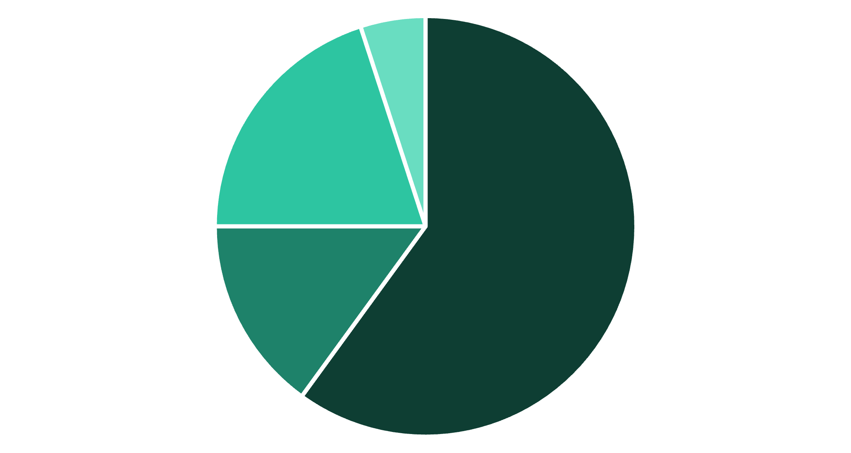
Tokenomics: Rewarding Integrity and Discovery
Token Utility
Payment for data access (Tier 2)
Staking for validation
Governance participation
Rewards for user contributions
Supply
Total: 50B $HUSH
Initial Circulating: 10M $HUSH (0.02%)
DePIN Rewards
Team
Foundation
Advisors
Quiet Discovery Multiplier (QDM)
Soundscape First-Mover NFT
Rewards quiet, stable, high-integrity data contributions
Digital badge for first user to map a new venue, providing future reward multiplier

Slide 14

Validated Prototype, Ready for Pilot
Interactive Noise Map
$HUSH Token Launch
AI Classification Model
Heatmap visualisation with venue markers, average noise levels, user ratings, and time-based filtering
Successfully launched on Mainnet with HTS NFT collection and smart contract managing token with full deployment support
Built and classifying noise into Quiet/Moderate/Loud categories with high accuracy
100+
100B+
Community Contributors
Datasets Ready
Internal testers and feedback gathered during testing phase
To be logged to Hedera Mainnet after hackathon/MVP phase

Slide 15

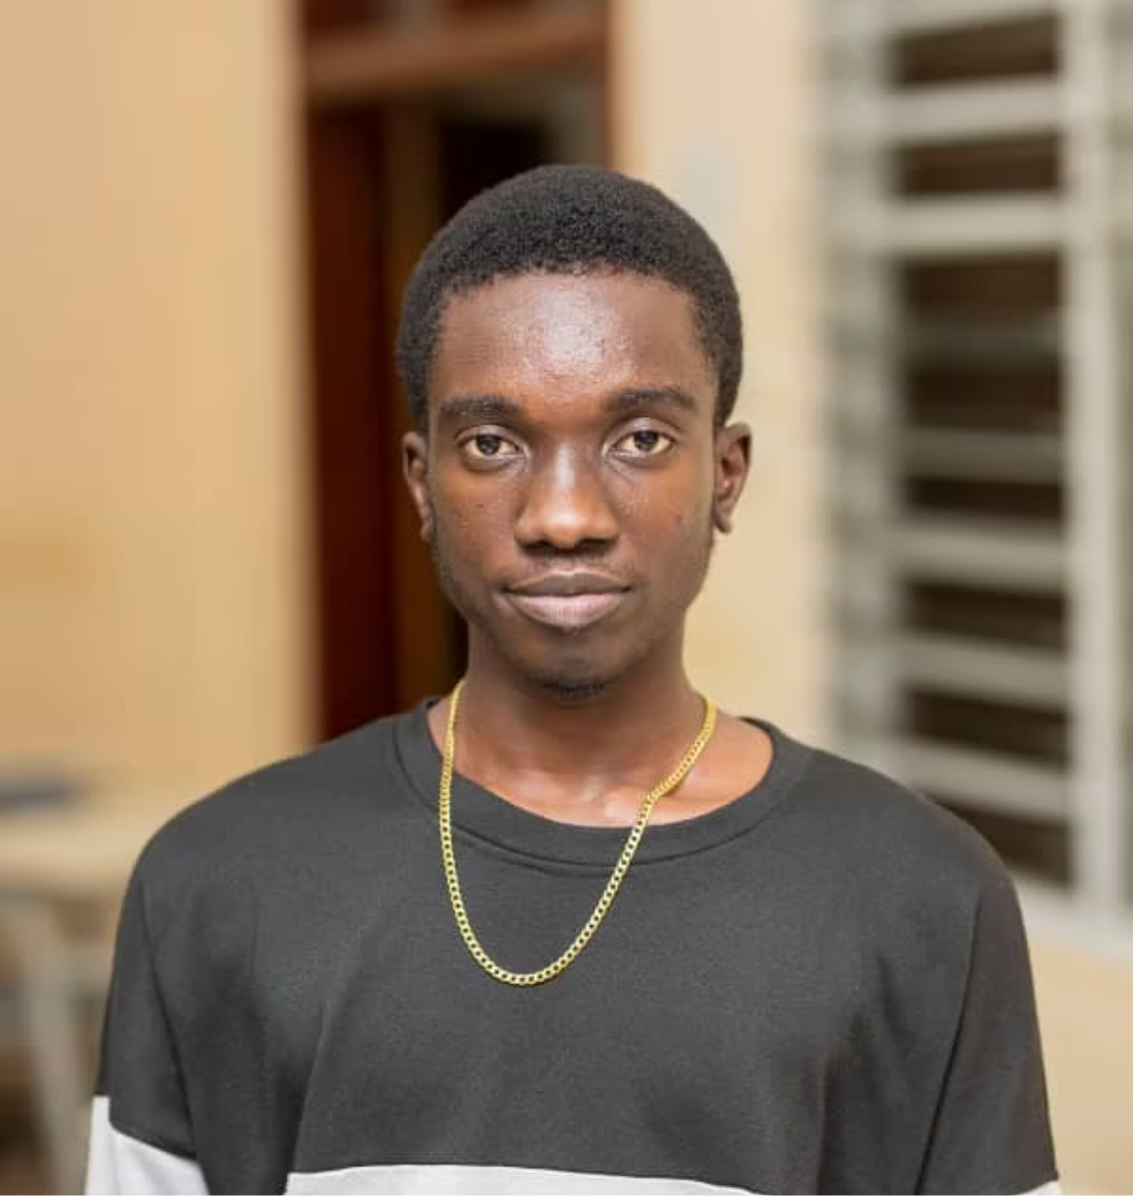

Built in Ghana, Scaled for the World
Elkanah Ametsitsi
Jeremiah Boateng
Paul Botchwey
Founder, Technical Lead
Smart Contract & Web Developer
Mobile Application Developer
Expertise in blockchain architecture, on-chain analytics, and Web3 tokenomics
Specialises in scalable smart contract systems and backend development for DApps
3+ years ensuring seamless, reliable user experience for core data collection tool
Our team's local base in Ghana provides first-hand domain expertise in the exact type of rapid, unmonitored urban environments we are targeting. We are building a solution for a problem we personally experience.

Slide 16
The Ask
Funding: $70,000 USD
Mentorship
Introductions
Guidance in regulatory compliance and B2G and B2B sales strategy
Key connections to Hedera Council members focused on urban planning and sustainability
Cover initial infrastructure costs and expand pilot programme to other countries

